Slide 1
Denoising single cell RNA sequencing data using Quantum State Tomography Ranga Sudharshan Swapnil Bhole (Team: Amplitude Architects)

Slide 2
🚀 Motivation and Challenges
Single-cell RNA-sequencing (scRNA-seq) enables transcriptome-wide profiling at the resolution of individual cells.
However, only 10–40% of transcripts are captured per cell due to technical inefficiencies (e.g., RT, PCR in droplets).
This leads to:
Undercounting of gene expression levels across all genes.
Dropout events: Lowly expressed genes are recorded as zero despite being active.
Dropout: Gene detected in some cells, but 0 in others despite expression.
Protocol-dependent: e.g., droplet-based platforms show higher dropout than Fluidigm
Naive imputation may erase real biological variation.

Slide 3
Existing Methods & Limitations
Method | Strengths | Weaknesses
MAGIC | Global smoothing on manifold | Alters all values, risks over-smoothing
SAVER | Bayesian gene-level modeling | Low recall, little improvement
CIDR/Seurat | Clustering with imputation hints | Not genome-wide; partial dropout model
scImpute | Dropout detection + imputation | Conservative, local cell-aware

Slide 4
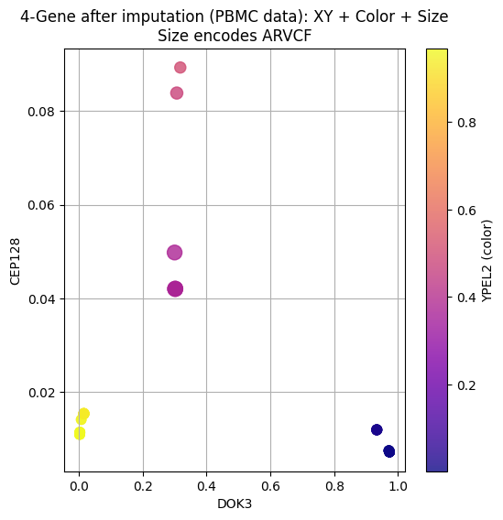
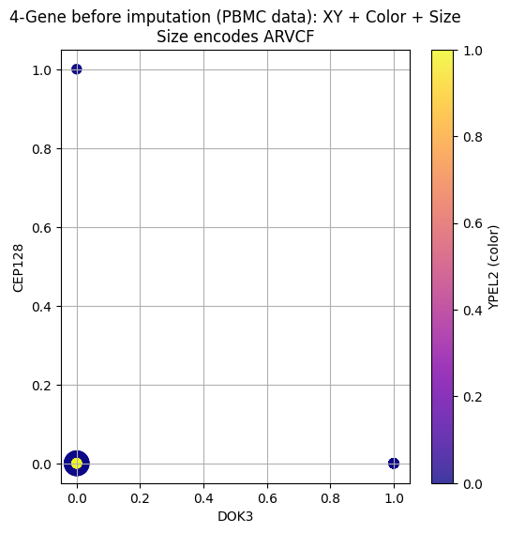
PBMC data before and after imputation

Slide 5
PBMC data before and after imputation
Aspect | Before imputation | After imputation
Expression sparsity | Most values = 0 (black/tiny) | Continuous values restored
Marker size | Sparse large circles | Smooth variation across cells
Color distribution | Almost all black or uniform | Full spectrum (purple → yellow)
Structure visibility | Hard to distinguish patterns | Easier to separate expression clusters

Slide 6
MAGIC: Markov Affinity-based Graph Imputation of Cells
MAGIC's Core Idea:
Build a cell-cell affinity graph to represent the data manifold.
Use Markov diffusion on this graph to propagate information and impute values.
Operates as a low-pass filter on the graph, smoothing noise while preserving structure.
Advantages:
Denoises and imputes simultaneously.
Model-free: makes no assumptions about data distribution.
Effective for both visualization and downstream gene–gene correlation recovery.

Slide 7
MAGIC: Markov Affinity-based Graph Imputation of Cells
Diffusion Time t: Number of steps the diffusion process runs.
Acts as a hyperparameter controlling how much the signal is smoothed.
Low t: retains noise; High t: risks oversmoothing real biology.
Dropout vs. Biological Zeros:
MAGIC spreads values across neighboring cells.
If neighbors have non-zero expression → dropouts are imputed.
If all neighbors are zero → biological zero is retained.
How t is Chosen:
Automatic selection by monitoring data change:
∥𝑋(𝑡)−𝑋(𝑡−1)∥
The knee point indicates the transition from noise reduction to signal degradation.

Slide 8
Quantum Pipeline Overview
Data Preprocessing
Normalize and log-transform scRNA-seq matrix
Select top highly variable genes (e.g., 4 → 4 qubits)
Dropout Simulation
Randomly set expressed values to 0 with a given dropout rate
Amplitude Encoding
Encode gene expression vector (padded to 2^n) into quantum amplitudes
Trotterized Time Evolution
Apply parameterized ansatz simulating quantum diffusion
Quantum State Tomography
Measure qubit Bloch vectors → reconstruct reduced density matrices
Use ρ00​ as recovered gene probability

Slide 9
QST Circuit Architecture
Quantum Components Used:
Amplitude Embedding: Normalized gene expression → quantum state ∣ψ⟩
Trotter Ansatz:
Simulates Hamiltonian time evolution e^{-iHt}
Uses parameterized Ising-like couplings Jij
Measurements:
Measure Pauli X, Y, Z expectations for each qubit
Reconstruct each qubit’s density matrix:
ρ = 0.5 ​(I+xX+yY+zZ)
Output: Use ρ00 = real[ρ[0,0]] as recovered gene expression (normalized)

Slide 10
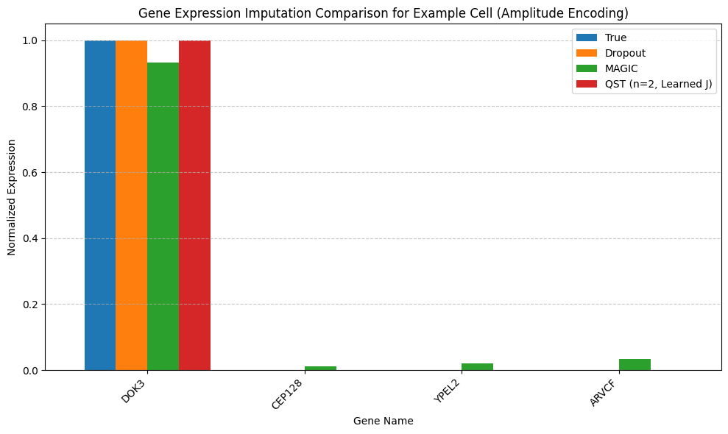
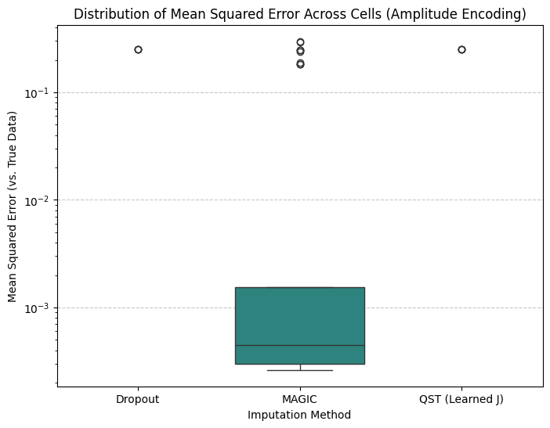
PBMC Dataset – QST vs MAGIC Results
Method | Mean MSE | Std Dev | Median | Max
Dropout | 0.0196 | 0.0679 | 0.0000 | 0.2500
MAGIC | 0.0460 | 0.0947 | 0.0005 | 0.2984
QST (Learned J) | 0.0196 | 0.0679 | 0.0000 | 0.2500

Slide 11
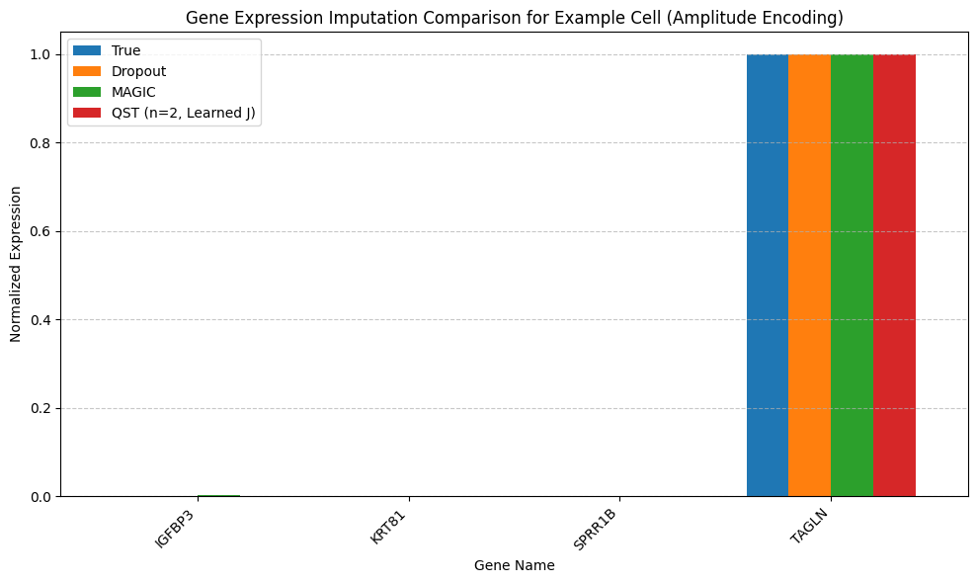
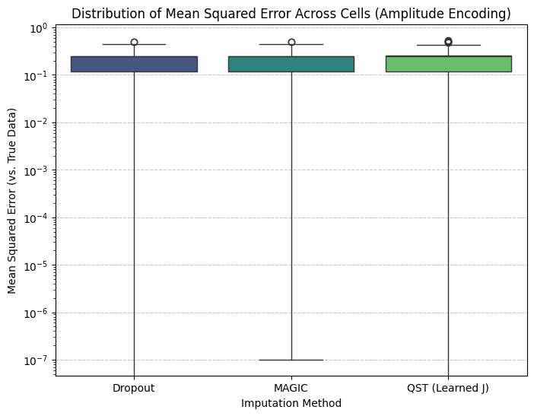
EMT Dataset – QST vs MAGIC Results
Method | Mean MSE | Std Dev | Median | Max
Dropout | 0.1954 | 0.0847 | 0.2500 | 0.5000
MAGIC | 0.1955 | 0.0844 | 0.2497 | 0.5016
QST (Learned J) | 0.2067 | 0.0940 | 0.2500 | 0.5406

Slide 12
Results & Insights
QST achieves same or lower MSE compared to MAGIC across the PBMC dataset
QST generalizes better when dropout is sparse and genes are well-encoded
On the EMT dataset, MAGIC slightly outperforms QST in terms of mean and max MSE.
This is due to the strong manifold structure in EMT data that MAGIC leverages via graph diffusion.
QST still reconstructs dominant signals (like TAGLN) well but may struggle with sparse or flat variance genes.
Takeaway: QST offers a principled quantum framework for denoising, useful in precision bioinformatics.

Slide 13
Comparison: MAGIC vs Quantum State Tomography (QST)
Feature | MAGIC | Quantum State Tomography (QST)
Type | Classical diffusion-based algorithm | Quantum-inspired simulation using amplitude encoding + trotterized ansatz
Imputation Principle | Diffusion on a data manifold: smooths values using k-nearest neighbors | Quantum state evolution & measurement recovers gene probabilities
Input Representation | Raw or normalized gene expression matrix | Amplitude-encoded quantum state (L2-normalized into 2ⁿ space)
Handles Dropout | Yes – relies on gene-to-gene similarity across cells | Yes – directly learns missing entries by optimizing quantum circuit params
Scalability | Scales well to thousands of cells and genes | Limited by number of qubits (currently 4–16 qubits feasible classically)
Parameter Training | No training – unsupervised smoothing method | Yes – learns optimal J-matrix (interactions) using gradient-based training
Noise Sensitivity | Robust to moderate noise | Sensitive to encoding errors, requires precise amplitude normalization
Tunable Parameters | Number of diffusion steps, t, and k-neighbors | Trotter steps (n), total time (t), J-parameters
Runtime (small dataset) | Fast (seconds) | Moderate (minutes for training)
Best Used When | Dropouts are random, smooth manifold assumption holds | Strong patterns exist, useful for sparse gene sets with learned structure
Limitations | Can oversmooth rare signals | Currently slower and limited by classical simulation of quantum circuits

Slide 14
References
https://dburkhardt.github.io/post/2018-10-28-magic/
https://www.nature.com/articles/s41467-018-03405-7#Sec8

Slide 15
Thank you
Amplitude encoding used in QST justifies our team name: Amplitude Architects
Questions?

